Slide 1

Software Security
Secure Design Principles
Modern Software Engineering: Principles and Practices, D. Xu, ISBN: 9798596959666

Slide 2
A Code Review Exercise
A Simple Web Server

Slide 3
References
Dianxiang Xu. Modern Software Engineering: Principles and Practices. 2021.
Neil Daswani, Christoph Kern, Anita Kesavan, Foundations of Security: What Every Programmer Needs to Know, APress, 2007.
Fred Long, Dhruv Mohindra, Robert C. Seacord, Dean F. Sutherland, David Svoboda, Java Coding Guidelines: 75 Recommendations for Reliable and Secure Programs, Addison-Wesley Professional; 1 edition. September 2013.

Slide 4
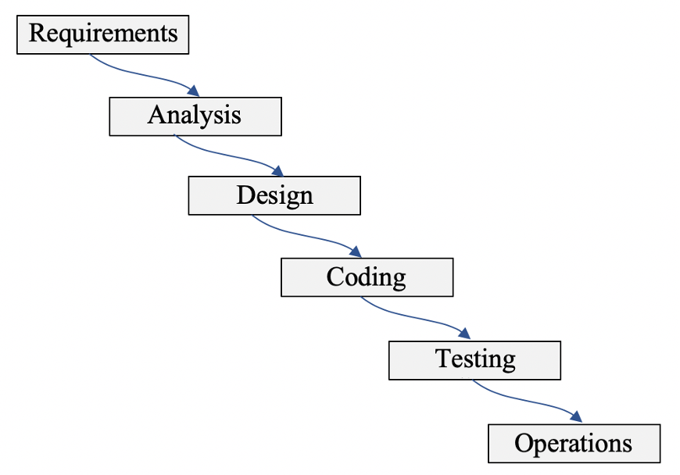
Waterfall vs. Problem Solving
Define the problem
Create a solution
Transform solution to code
Verify and validate the
problem and solution

Slide 5
What Is Design?
Design is the creative process of transforming the problem into a solution
The description of a solution is also known as design
The requirements specification defines the problem
The design document specifies a particular solution to the problem
Steve McConnell. Code Complete: A Practical Handbook of Software Construction. 2nd Edition. Microsoft Press, 2004.

Slide 6
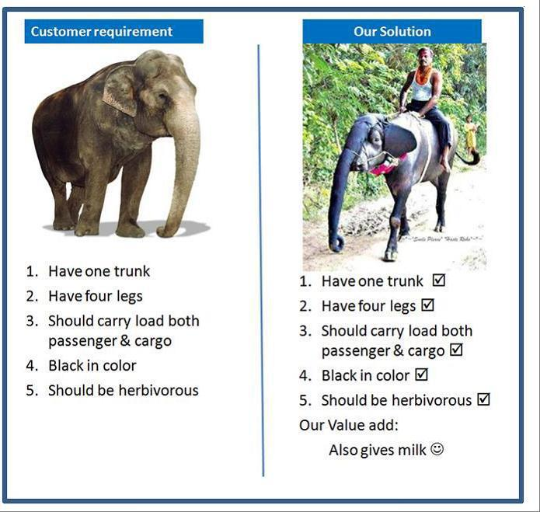

Slide 7
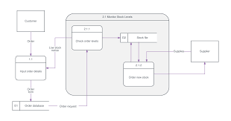
Design Process
Requirements
Design
Methods
Techniques
Patterns
User stories
Principles and Heuristics
System Specification
Can be made more systematic and predictable through the application of methods, techniques and patterns, all applied according to principles and heuristics

Slide 8
A Simple Web Server
HTTP: hypertext transfer protocol
Default port: 80
GET / HTTP/1.0
“/”: root document, usually index.html
Return error message if file is not found
Web browser (Client)
Web Server
GET <filename> <http-version>
<http-version> 200 OK
<file content>
Neil Daswani, Christoph Kern, Anita Kesavan, Foundations of Security: What Every Programmer Needs to Know, APress, 2007.

Slide 9
Socket Programming: Review
Socket programming
A means of communicating data between two computers across a network.
Socket
A communication endpoint that serves as a link between two machines
Server Socket
Awaits a request from a client through a port number
Client Socket
Establishes communication with a server
Using the server’s IP address and the port number

Slide 10
SimpleWebServer: Demo
Compile and Run SimpleWebServer.java
Lunch browser
http://localhost:8080/index.html
http://localhost:8080/src/simpleWebServer/SimpleWebServer.java
Compile and Run SimpleWebClient.java
GET /
GET index.html
GET /src/simpleWebServer/SimpleWebServer.java
Change host (umkc.edu) and port (80)
Notes:
(3) Run SimpleWebServer and SimpleWebClient on different computers?

Slide 11
Exercise: Testing for Security
Can you break the server program?
If so, is it a security failure? why?
Use SimpleWebClient.java rather than a normal web browser
A client may create his own browser program!

Slide 12
Sample Attacks
GET /../secret.txt
GET /../../Blackjack.zip
GET

Slide 13
Code Review: Code Structures
What are the methods and their functions?
What are the relationships among methods (method invocations)?

Slide 14
Web Server: Program Structure
Main/run
Wait for connection
Process request
Serve file
Notes:
Single-threaded

Slide 15
Process Request (socket)
Create reader
Create writer
Get request
Get command
Get path
yes
Command = GET?
Serve file (writer, path)
no
Error Message
Notes:
Get command/path -> Denial of service due to exception -> handle exceptions
Get request -> denial of service if the client never sends data/disconnect (single-threaded)

Slide 16
Serve File (writer, path)
Create buffer
yes
Remove / from path
path starts with / ?
no
yes
path ← index.html
path is empty?
no
fail
Output error message
Open path
succeed
Output ok message
Read file to buffer
Output buffer content
Notes:
Create reader and Open path -> Elevation of privilege -> check path
Read file to buffer (assuming finite length) -> non-fail-safe; denial of service due to running out of memory by infinite data (e.g., misuse of /dev/random) -> limit length, don’t store file in memory

Slide 17
Exercise: Code Review for Security
How many vulnerabilities can you find in SimpleWebServer.java?
Why are they vulnerabilities?
You may test the program to verify your suspicion.

Slide 18
Process Request (socket)
Create reader
Create writer
Get request
Get command
Get path
yes
Command = GET?
Serve file (writer, path)
no
Error Message
Notes:
Get command/path -> Denial of service due to exception -> handle exceptions
Get request -> denial of service if the client never sends data/disconnect (single-threaded)

Slide 19
Serve File (writer, path)
Create buffer
path starts with / ?
yes
Remove / from path
no
yes
path ← index.html
path is empty?
no
fail
Output error message
Open path
succeed
Output ok message
Read file to buffer
Output buffer content
Notes:
Create reader and Open path -> Elevation of privilege -> check path
Read file to buffer (assuming finite length) -> non-fail-safe; denial of service due to running out of memory by infinite data (e.g., misuse of /dev/random) -> limit length, don’t store file in memory
Communication is not secured.
Serve single client at a time

Slide 20
Secure Design Principles
Minimal Attack Surface
Least Privilege
Defense-in-Depth
Fail-Safe Stance
Secure by Default
Separation of Duties
Avoidance of Security Through Obscurity
Robust Resource Management
Forensic Readiness
Security Features ≠ Security

Slide 21
1. Minimal Attack Surface
Attack Surface
The sum of the different points for attack vectors by which the adversary may exploit vulnerabilities to deliver a payload or malicious outcome.
Reducing the attack surface will reduce risks.
Sample methods
Reduce the amount of code running
Reduce entry points available to untrusted users.
Turn off unnecessary functionality
Reduce privileges to limit damage potential.
In OOD, the minimum visibility should be given to classes and class members
Avoid exposing methods that contain or invoke sensitive code through interfaces

Slide 22
2. Least Privilege
A user (human, software, or hardware) is given the least privileges necessary to accomplish a task
Just enough authority to get the job done.
If an extra privilege is required of a task, the extra privilege should only be accessed for the least amount of time required and relinquished immediately upon completion of the task
Common world example: Valet Keys
Valets can only start the car and drive to a parking lot
Highly elevated privileges unnecessary
Example: valet key should not open the glove compartment
Web server Example: can read, not modify, html file
Chain of trust / privileges

Slide 23
The SimpleServer Example
If it runs under root, clients could access all files
serveFile() creates FileReader for arbitrary pathname provided by user
GET../../etc/shadow HTTP/1.0
Traverses up to root, /etc/shadow (UNIX) - usernames & encrypted pswds
Attacker can launch a dictionary attack
Need to canonicalize/validate pathname

Slide 24
Canonicalizing Pathnames
checkPath(): ensure target path is below current path and no .. in pathname
Then serveFile() uses normalized path
String checkPath (String pathname) throws Exception {
File target = new File(pathname);
File cwd = new File(System.getProperty("user.dir"));
/* User's current working directory stored in cwd */
String targetStr = target.getCanonicalPath();
String cwdStr = cwd.getCanonicalPath();
if (!targetStr.startsWith(cwdStr))
throw new Exception("File Not Found");
else return targetStr;
}
fr = new FileReader (checkPath(pathname));
Notes:
Note: current web browsers (Firefox) use normalized paths.

Slide 25
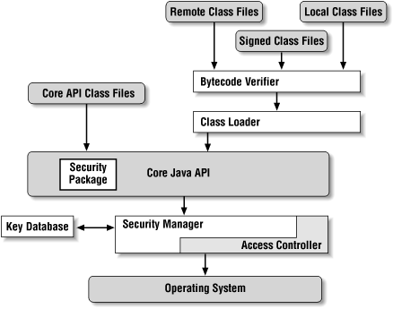
Java Security Architecture

Slide 26
A Vulnerability in Java 1.7 Update 6
Widely exploited in August 2012
The applet class loader ensures that an applet cannot directly invoke methods of classes in the com.sun.* package
Security manager grants or denies actions depending on the privileges of caller methods on the call stack.
The fist goal of the exploit aims to access the com. sun.awt.ToolKit class but invoking Class.forName() directly would cause SecurityException
Class t = Class.forName("java.lang.Thread") returns the runtime Class descriptor for the class named java.lang.Thread
The exploit used a GetClass method to bypass the security manager & access any class.
Notes:
com. sun.awt.ToolKit is the abstract superclass of all actual implementations of the Abstract Window Toolkit. Subclasses of the Toolkit class are used to bind the various components to particular native toolkit implementations.

Slide 27
Exploit -1
// Malicious code
Private Class GetClass(String paramString) throws Throwable{
Object arrayOfObject [] = new Object[1];
arrayOfObject [0] = paramString;
Expression localExpression
= new Expression(Class.class, “forName”, arrayOfObject);
localExpression.execute();
return (Class)localExpression.getValue();
}
java.beans.Expression: represents a primitive expression in which a single method is applied to a target and a set of arguments to return a result - as in "a.getFoo()"
java.beans.Expression.execute(): invokes the method on the target. It delegates its work to another private method: invokeInternal().
Notes:
invokeInternal is a private method in java.beans.Expression.

Slide 28
Exploit -2
private Object invokeInternal() throws Exception{
Object target = getTarget();
String methodName = getMethodName();
if (target==null || method==null) {
throw new NullPointerException(“…. should not be null”);
}
Object[] arguments = getArguments();
If (arguments = null) { arguments = emptyArray;}
// Class.forName won’t load classes outside of core from a class
// inside core, so it is handed as a special case
if (target==Class.class && methodName.equals(“forName”)) {
return ClassFinder.resolveClass((String)arguments[0]), this.loader);
}
//… com.sun.beans.finder.ClassFinder.resolveClass() delegates its
// work to its findClass() method
}

Slide 29
Exploit -3
public static Class<?> findClass(String name)
throws ClassNotFoundException {
try { ClassLoader loader =
Thread.currentThread().getContextClassLoader();
if (loader==null) { loader=ClassLoader.getSystemClassLoader();}
if (loader!=null) { return Class.forName(name, false, loader); }
} catch (ClassNotFoundException exception) { // use current loader
} catch (SecurityException exception) { // use current loader}
return Class.forName(name);
}
findClass is called in the context of an applet, but it uses Class.forName() to obtain the requested class.
The calling class class com.sun.beans.finder.ClassFinder is part of core Java.
The trusted class loader is unaware that it is acting on behalf of malicious code.

Slide 30
Exploit -4
How to attack: Find the broken chain of trust
Malicious Goal: Class.forName() – privileged access
5. com.sun.beans.finder.ClassFinder.findClass()
4. com.sun.beans.finder.ClassFinder.resolveClass()
3. java.beans.Expression.invokeInternal()
2. java.beans.Expression.execute()
1. Malicious unprivileged code
Fixed in Java 1.7.0 update 7
Checks the entire call stack to ensure Class.forName fetches classes only on behalf of trusted methods.

Slide 31
Exploit -5
public static Class<?> findClass(String name)
throws ClassNotFoundException {
checkPackageAccess(name); // fix in Update 7
try {
ClassLoader loader =
Thread.currentThread().getContextClassLoader();
if (loader==null) {
loader = ClassLoader.getSystemClassLoader();
}
if (loader!=null) {
return Class.forName(name, false, loader);
}
} catch (ClassNotFoundException exception) { // use current loader
} catch (SecurityException) { // use current loader}
return Class.forName(name);
}

Slide 32
3. Defense-in-Depth
Manage security risks with layers of defense
Don’t rely on any one for security
Originated from the military strategy to “provide barriers to impede the progress of intruders from attaining their goals while monitoring their progress and developing and implementing responses to the incident in order to repel them.”
Secure software design should consider preventive, detective, and protective measures to impede the progress of an intrusion and reduce its consequences.

Slide 33
Defense-in-Depth – Examples
Banks
Security Guards, Bullet-Proof, Teller Window, Dye on Money
Protect sensitive info
Firewall
Authentication
Encrypted storage
Encrypted messages

Slide 34
Prevent, Detect, Contain, and Recover
Layered defense
Prevent attacks, detect breaches, contain attacks in progress, and recover from them
Detection particularly important for network; it may not be clear when an attack is occurring
Preventive techniques not perfect; treat mali-cious traffic as a fact, not exceptional condition
Have containment procedures planned out in advance to mitigate damage of an attack
Ex: If a thief removes a painting at a museum, the gallery is locked down to trap him.

Slide 35
Password Security Example
Prevent
Require users to choose strong passwords to prevent guessing attacks
Detect
Monitor server logs for large # of failed logins coming from an IP address; Mark it as suspicious
Contain
Deny logins from suspicious IPs or require additional checks (e.g., cookies)
Recover
Monitor accounts that may have been hacked, deny suspicious transactions

Slide 36
4. Fail-Safe Stance
If a system is going to fail, it should respond in a way that keeps the system in a safe state and causes minimal or no security violation.
Common world example: Elevators
Designed with expectation of power failure
In power outage, can grab onto cables or guide rails
Expect & plan for failure and exception
The software should be kept in a state that denies rather than grants access
It should not report error messages that reveal useful information to malicious users.

Slide 37
The SimpleServer Example
Read file into buffer
Attacker could use /dev/random, infinite length file
public void serveFile (OutputStreamWriter osw,
String pathname) throws Exception {
FileReader fr=null;
int c=-1;
StringBuffer sb = new StringBuffer();
...
while (c != -1) {
sb.append((char)c); // if memory run out, crashes!
c = fr.read();
}
osw.write (sb.toString());

Slide 38
SimpleServer: Check File Length
One fix: have a default maximum amount of data to read from the file
Only serve file if sufficient memory available
Still doesn’t work for /dev/random
A special file whose length is reported as 0 (it doesn’t exist on disk)
pathname = checkPath(pathname); // canonicalize
File f = new File (pathname);
/* ... */
if (f.length() > Runtime.getRuntime().freeMemory()) {
throw new Exception();
}

Slide 39
SimpleServer: Don’t Store File in Memory
Instead of storing the bytes of the file before sending it, just stream it
Problem: /dev/random causes server to be forever tied up servicing attacker’s request
Can’t serve other legitimate requests
DoS still possible
while (c != -1) {
osw.write(c); // No StringBuffer storage
c = fr.read();
}

Slide 40
…and Impose a Download Limit
To properly defend against /dev/random attack, need to impose max download limit
Tradeoff
limit too low, legitimate files get truncated
limit too high, DoS still a threat from abusive requests
while ((c != -1)&&(sentBytes<MAX_DOWNLOAD_LIMIT)){
osw.write (c);
sentBytes++;
c = fr.read();
}

Slide 41
5. Secure By Default
Software must be secure by default
The default configuration must use the most secure settings possible
It should not turn on every possible feature or make every service available to the user by default
A user/program should be denied access to an object unless:
It is given explicit access to that object or
The access request is found to be consistent with security policy

Slide 42
Secure By Default – cont’d
“Hardening” a system
Turn all unnecessary services off by default
Enabling more features means more potential exploits and decreased security
Example: Windows OS
All features turned on to make users hooked
There were lot of viruses like Code Red and Nimda which exploited IIS (Internet Information Services) vulnerability
Notes:
IIS: Internet Information Services for Windows® Server

Slide 43
6. Separation of Duties
An internal control that prevents fraud/errors by disseminating a task and associated privileges among multiple users.
It provides an appropriate level of checks and balances upon users' activities (duties).
Examples:
A task may require signatures or approvals of two persons per the four-eyes principle.
A security key may be split into two or more parts between responsible persons.
An online shopping application should separate the duties of customers and administrators.
An administrator should not do what customers do (e.g., order items from the front end).

Slide 44
Separation of Duties – cont’d
Implementation
Identify the set of duties
Establish the control rules, e.g., to avoid conflict of interest
Assign the duties according to the rules.

Slide 45
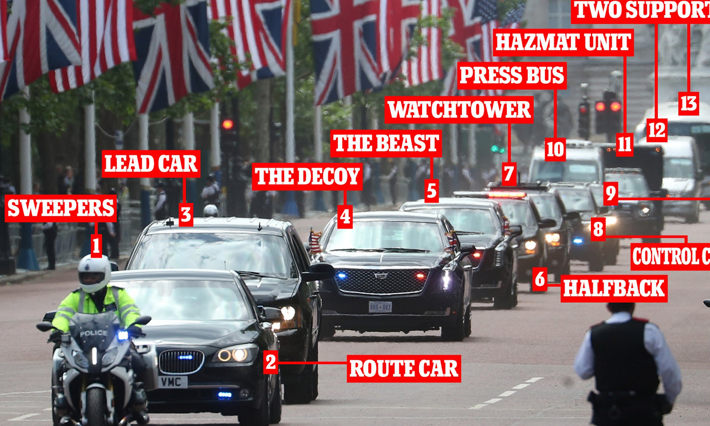
Security Through Obscurity (STO)
The president goes from A to B with his 30-car convoy
He is not sitting in his presidential car so that the attacker won’t target him easily.
He can be in any car, reducing the risk of an attack.
https://utkusen.com/blog/security-by-obscurity-is-underrated

Slide 46
STO: Code Obfuscation
Make code difficult to decompile/disassemble or difficult for humans to parse.
Name obfuscation: using random variable names for a web application
Control flow obfuscation: modify the logical structure to make it less predictable and traceable
Arithmetic obfuscation: convert simple arithmetic and logical expressions into complex equivalents
Code virtualization: transform code into instructions for randomly generated virtual machines
Indistinguishable obfuscation: cryptographically hard
https://www.guardsquare.com/what-is-code-obfuscation
Notes:
STO can reduce security risks, but only before someone has discovered the obscurity. It may lead to a false sense of security.

Slide 47
7. Avoidance of STO Reliance
Security Through Obscurity (STO): reliance on the design or implementation secrecy as the security method.
Hide sensitive information (e.g., license keys and passwords) inside binary code
Hide version info from the public to reduce the chance of a vulnerable and outdated version being exploited.
Keep the software specification secret so that only the most trusted people have permission to read.
Using a different port to reduce the number of brute force attacks against specific ports
Obscurity should never be the only security mechanism of software.
Notes:
STO can reduce security risks, but only before someone has discovered the obscurity. It may lead to a false sense of security.

Slide 48
8. Robust Resource Management
DoS attacks aim at exhaustive consumption of the system resources, such as CPU cycles, memory, disk space, and file descriptors.
Resource management: not only performance issue, but also defense against malicious resource consumption
Good practices
Remove temporary files when no longer required
Ensure the resources are closed when not needed.
Perform proper cleanup at program termination.
Avoid memory / resource leaks during serialization.
Use thread pools to enable graceful degradation of service

Slide 49
9. Forensic Readiness
Digital forensics: identify, preserve, recover, analyze, and present digital evidence in a forensically sound manner.
The evidence may be used in a court of law.
What has happened, when and how it happened, and who was responsible
Monitoring and logging (audit trail)
Critical events and related data should be logged.
The log data should not be accessible to unauthorized users or tampered with by the adversary.
The log data should be captured in a way that facilitates investigations. It may be different from the output of normal operations.
Notes:
No software is absolutely secure

Slide 50
10. Security Features ≠ Security
Using one or more security features will not solve all problems!
Using encryption doesn’t protect against weak pswd.
Using SSL doesn’t protect against buffer overflows.
Schneier: “Security is a process, not a product!”
Can never be completely secure, just provide a risk assessment
Attacker only needs to find ONE flaw, designers have to try and cover ALL possible flaws
Security features can help, but can’t stop bugs

